Slide 1
Best PowerPoint Template for Teachers
A template by Growzania
A great presentation gives smart ideas an advantage
- Nancy Duarte
Notes:
Icons made by Freepik from www.flaticon.com

Slide 2
Today’s agenda
1
3
Introduction to the topic
The Details
2
4
Team check in & ice breakers
Summary & Action Items

Slide 3
Meet today’s teachers
A quick introduction
Kim
Janet
Kim and Janet will be our
facilitators for this session.
The goal of today is to give clarity on today’s topic.
As your teachers, our role is to engage and make sure all students participate.

Slide 4
Team check in
How are you feeling today?
Time: 3 minutes

Slide 5
A quick icebreaker
Suggestions for icebreaker questions:
What's the best piece of advice you've ever been given?
When you die, what do you want to be remembered for?
What is your favorite item you've bought this year?
What would be the most surprising scientific discovery imaginable?
What is your absolute dream job?
Time: 5 minutes

Slide 6
Let’s get started
Are you excited?

Slide 7
Introducing the topic
Our topic of today can be divided into 6 elements. Each of these 6 elements defines the greatness of the topic.
1
The first element to be discussed
3
5
The third element
The fifth element
2
The second element to be discussed
4
The fourth element of our topic
6
The last element we will dive into

Slide 8
A brief quote/extract about this first element
Element 1:
The first element we will discuss.
What is the key take out from this element?

Slide 9
Tell me and I forget.
Teach me and I remember.
Involve me and I learn.
Benjamin Franklin

Slide 10
Element 2:
The second element.
What are we learning about this topic?
How is it relevant to our day to day life?
Use these sticky notes to highlight some key points
Use these sticky notes to highlight some key points
Use these sticky notes to highlight some key points
1
2
3

Slide 11
A brief quote/extract about this first element
Element 3:
The third element.
What is the key take out from this element?

Slide 12
Element 3: The timeline
Some thing about this point in time
Some thing about this point in time
Some thing about this point in time
1
2
3
4
5
6
Some thing about this point in time
Some thing about this point in time
Some thing about this point in time

Slide 13
A quote related to this element
A quote related to this element
- Someone great
- Someone great
Element 4:
The fourth element.
A quick call out related to this element
A quick call out related to this element

Slide 14
Visual communication
SIMPLE
CREDIBLE
IMPACTFUL
VISIBLE
Communicate effectively by using visual patterns.
Communicate effectively by using visual patterns.
Communicate effectively by using visual patterns.
Communicate effectively by using visual patterns.

Slide 15
A quote related to this element
A quick call out related to this element
- Someone great
Element 5:
The fifth element.

Slide 16
Two (2) points in one slide
Point 1
Point 2
Here is what you need to know about this point. Keep it short and to the point to make it easy to read.
Here is what you need to know about this point. Keep it short and to the point to make it easy to read.
Summary
Summary
You can add a quick note about this point here.
You can add a quick note about this point here.

Slide 17
A quote related to this element
A quote related to this element
- Someone great
- Someone great
Element 6:
The last element.
A quick call out related to this element
A quick call out related to this element

Slide 18
The 6th element
Item 1
Item 2
1
Some text to describe this
Some text to describe this item
Some text to describe this item
2
Feel free to add a bit more details to make it easy to understand
Item 3
Item 4
Some text to describe this item
Some text to describe this item
Some text to describe this item

Slide 19
Let’s summarize

Slide 20
1
Spell out the action items using these boxes.
Action Items
It is always important to summarize the key learnings into action points or take outs for the students.
2
This is the second action item that needs to be called out.

Slide 21
Thank you
Have a great day ahead!

Slide 22
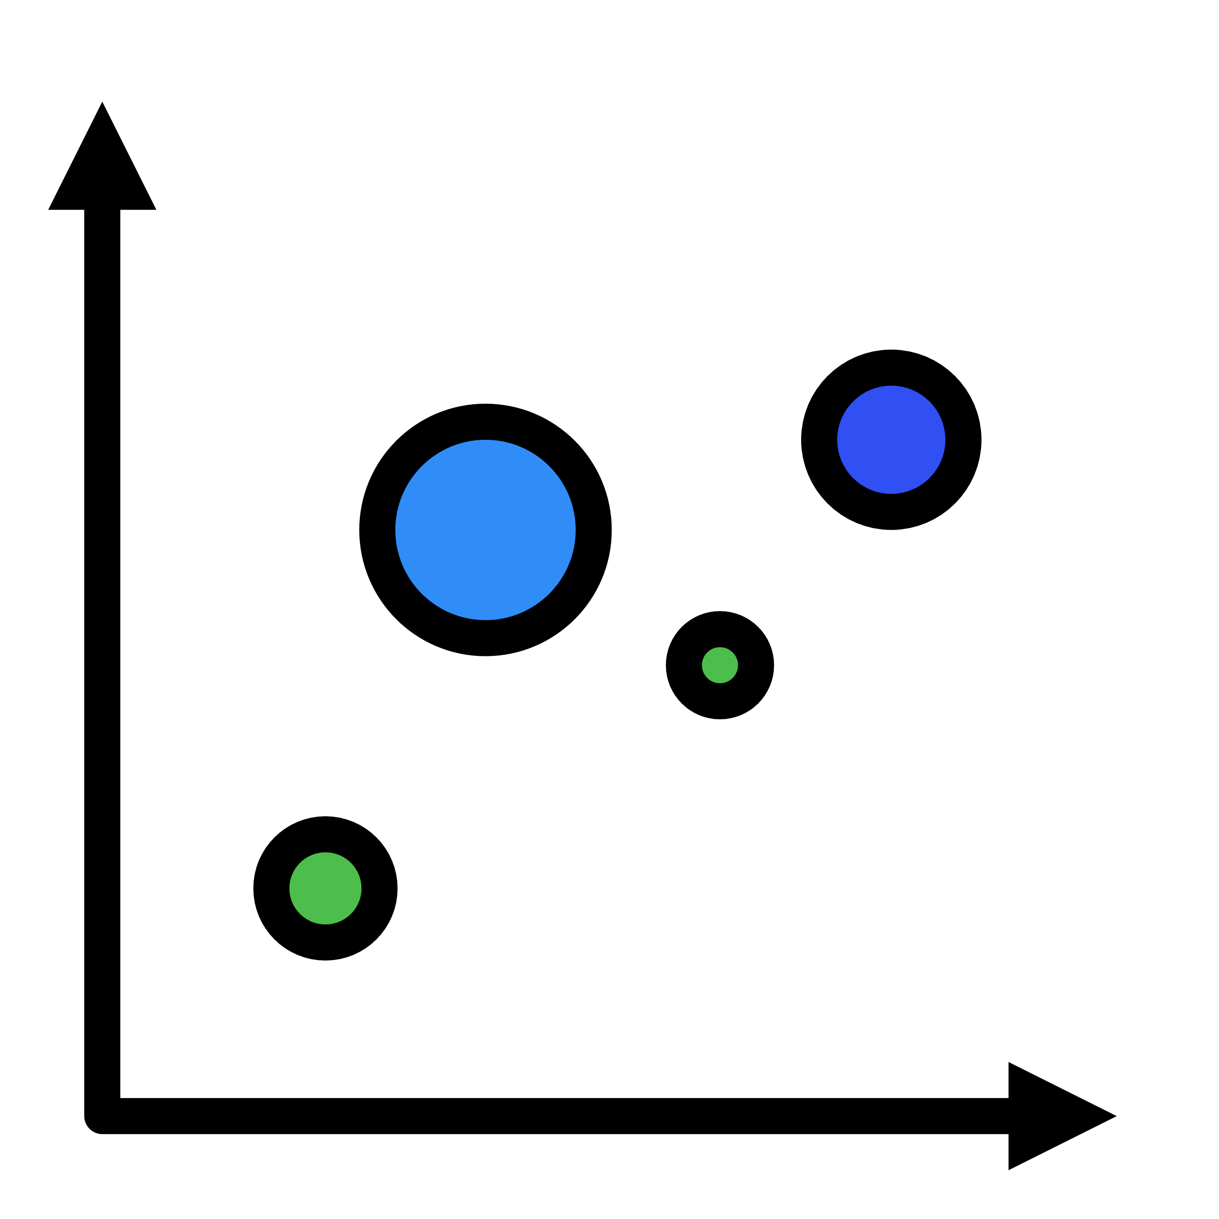
Icons and Illustrations Resource Page
Use these free recolorable icons and illustrations in your PowerPoint design.
Notes:
Icons by svgrepo.com

