Slide 1
ELEGANCE POWERPOINT TEMPLATE

Slide 2

Today’s agenda
Best to use bullet points for the agenda
If you prefer, you can add a title to spice up the agenda
List the topics covered in this presentation
You can also add a call out for how long each topic or section is
Add any breaks you have in the presentation as well.

Slide 3

Today’s speakers
Kim is today’s facilitator.
The goal of today is to give clarity on today’s topic. As your speaker, my role is to engage and make sure all students participate.

Slide 4


Meet today’s speakers
Kim and Janet will be our facilitators for this session.
The goal of today is to give clarity on today’s topic. As your speaker, my role is to engage and make sure all students participate.

Slide 5



QUICK CHECK IN
How are you feeling today?
Time: 3 minutes

Slide 6
ICE BREAKER
What's the best piece of advice you've ever been given?
When you die, what do you want to be remembered for?
What is your favorite item you've bought this year?
What would be the most surprising scientific discovery imaginable?
Time: 5 minutes

Slide 7
LET’s GET STARTED
Are you excited?

Slide 8
Introducing the topic
Our topic of today can be divided into 6 elements. Each of these 6 elements defines the greatness of the topic.
1
The first element to be discussed
3
5
The third element
The fifth element
2
The second element to be discussed
4
The fourth element of our topic
6
The last element we will dive into

Slide 9
A great presentation gives smart ideas an advantage.
-Nancy Duarte

Slide 10

Introduction
It is good to start off by introducing the topic.
You can also use this slide to create an ice breaker or a team check-in.
Feel free to formulate questions that will lead to a better discussion.
Duplicate this page as many times as you need.

Slide 11
Comparing two concepts
Concept 1
Concept 2
Make the discussion more lively by dividing some key concepts and using visual displays.
This will make it easy to retain information.
Make the discussion more lively by dividing some key concepts and using visual displays.
This will make it easy to retain information.

Slide 12
Comparing THREE concepts
Concept 1
Concept 2
Concept 3
Make the discussion more lively by dividing some key concepts and using visual displays.
This will make it easy to retain information.
Make the discussion more lively by dividing some key concepts and using visual displays.
This will make it easy to retain information.
Make the discussion more lively by dividing some key concepts and using visual displays.
This will make it easy to retain information.

Slide 13

Explaining the details
Concept 1
Use this space to explain the concept in detail.
Use bullets to make it clearer.
Concept 2
Use this space to explain the concept in detail.
Use bullets to make it clearer.

Slide 14
TOPIC | Chart comparisons
Bar chart
Line chart

Slide 15
You can use tables too
 | A | B | C
City 1 | 1 | 2 | 3
City 2 | 4 | 5 | 6
City 3 | 7 | 8 | 9

Slide 16
Use sections to break the content
Add breaks to create discussions and allow questions.

Slide 17

So… why are we here today?
Adding a rhetorical questions is a great technique to keep audience attentive.

Slide 18

Should we always aim to learn?
Adding a rhetorical questions is a great technique to keep audience attentive.

Slide 19

How many google searches happen every second?
You can also ask a general knowledge question.
While the audience is trying to come up with a number, we’ll surprise them with the next slide.

Slide 20

40,000 searches per second!
Remember, the aim is to shock the audience. Therefore, highlight what is unexpected about this answer.

Slide 21
OUR TIMELINE
Some thing about this point in time
Some thing about this point in time
Some thing about this point in time
1
2
3
4
5
6
Some thing about this point in time
Some thing about this point in time
Some thing about this point in time

Slide 22




VISUAL COMMUNICATION
SIMPLE
CREDIBLE
IMPACTFUL
VISIBLE
Communicate effectively by using visual patterns.
Communicate effectively by using visual patterns.
Communicate effectively by using visual patterns.
Communicate effectively by using visual patterns.

Slide 23
TWO POINTS, ONE SLIDE
Point 1
Point 2
Here is what you need to know about this point. Keep it short and to the point to make it easy to read.
Here is what you need to know about this point. Keep it short and to the point to make it easy to read.
Summary
Summary
You can add a quick note about this point here.
You can add a quick note about this point here.

Slide 24
HIGHLIGHTS
Revenue
Brand mentions
>100K
Source of visitors
Visitor feedback
Improve navigation
Great website

Slide 25

MEET JANICE
Young female, first year in job
25 years old
First “serious” job
Still contemplating freelancing as influencer
She loves photos, and takes selfies any time she can
Loves experimenting with food, especially new recipes.
Always paint the consumer problem using a picture.

Slide 26

MEET EDWIN
Visionary, Entrepreneur
25 years old
Recently started his tech venture
Raised $100k from angel investor
Works 15 – 20 hours a day on improving the customer experience
A picture tells a lot more than just words.

Slide 27
WHO IS OUR CONSUMER?
They love Netflix and chill!
They use Snapchat and TikTok
They are mostly female
They are aged between…
They love Mexican shows

Slide 28
WHAT CUSTOMERS ARE SAYING
With this TEMPLATE, I’m MORE confident WHEN PREPARING MY TALK!
TIMOTHY, STUDENT, TX
Visual COMMUNICATION MADE SIMPLE
BEN, LECTURER, LONDON
GROWZANIA HAS OFFICIALLY INSPIRED ME TO BE BETTER!
ELIZABETH, PR, AUSTRALIA
Quotes for illustration purposes only

Slide 29
Action items
1
Spell out the action items using these boxes.
It is always important to summarize the key learnings into action points or take outs for the students.
2
This is the second action item that needs to be called out.

Slide 30
Thank you
Have a great day ahead!
GET IN TOUCH
@GrowZania
support@growzania.com

Slide 31


















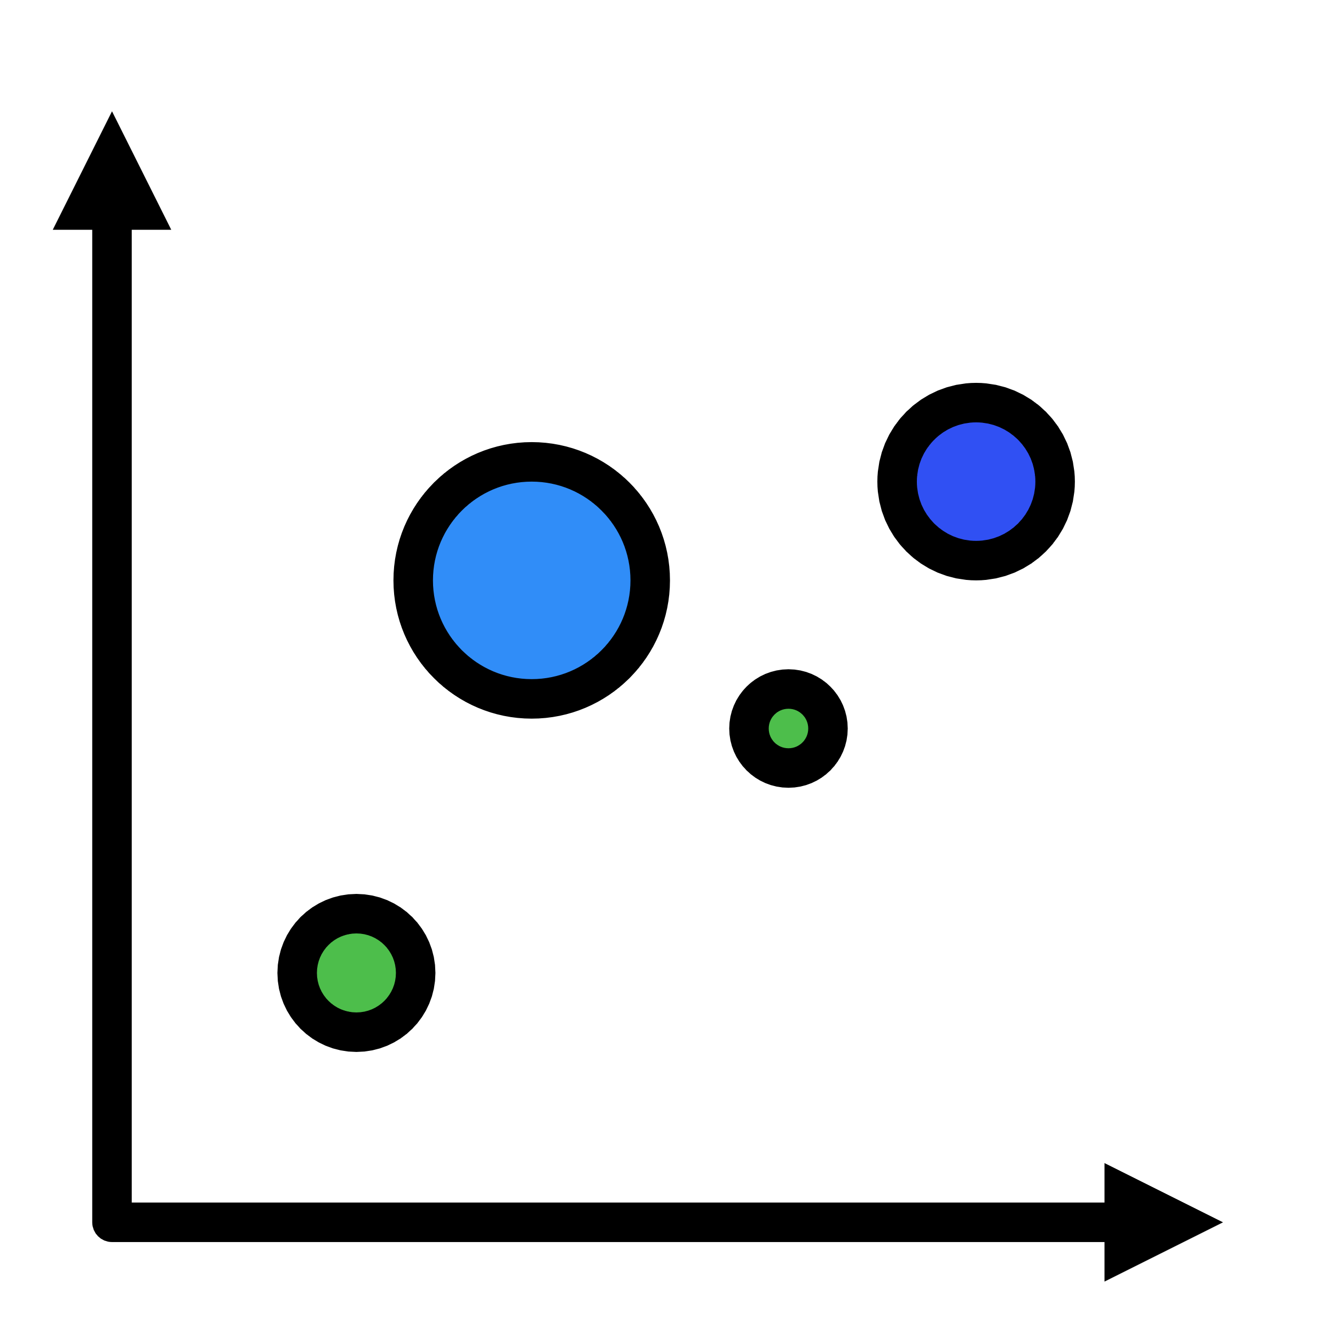














Icons and Illustrations Resource Page
Use these free recolorable icons and illustrations in your PowerPoint design.

Slide 32





Free templates to help you be better!
Templates work with both Microsoft PowerPoint and Google slides.
Available 100% free for both personal and commercial use. No attribution required ☺.
Ready to use out of the box. Clean, professional and highly customizable
Engage and wow your audience with great visuals and structure!

